Slide 1
Courier Database Management System
IST 659
Sangam ludhani
Kshitij sankesara

Slide 2
Project goals:
Major functions of Courier Database system are -
To design a database for a Courier delivery organisation.
Three important aspects of courier delivery - Status tracking, Route chosen and pricing information.
To increase automation and reduce manual effort by giving features like price calculation and self-tracking of the parcel.

Slide 3
Project goals :
Important points and features that this design incorporates are as mentioned below:
Total distance to be covered will be calculated on basis of source and target zipcodes.
3 types of delivery type can be chosen (Normal, speed and express).
Pricing information will be calculated on basis of the delivery type chosen, total weight of the package and total distance to be covered.
The route will be chosen on basis of zipcodes covered by the warehouse.
Every package can be tracked using their unique PackageID.
Information about the packages and their targeted warehouse can be easily available.

Slide 4
Business rules:
Route will be chosen based on the zipcodes covered by warehouse mentioned in the table Route details.
Depending on standard rates, pricing of the package will be decided.
Delivery type of parcel can be of 3 different types i.e. normal, speed and express
Every package will have a single pricing based on the total distance, total weight and delivery type chosen.
In status tracking table, if package status is a failure then field reason of failure needs to be updated.
One customer can send one or more packages to different destination.
Every package would have a unique id based on which its status can be tracked and pricing can be seen.

Slide 5
Project goals:
Major Data Questions –
1. Track the status of all package in the month of November
2. Total revenue made by Courier Company in each year.
3. Calculate city wise revenue made by company
4. Find the routes/zipcodes (where the company operates) but usually no packages are being sent
5. Busy warehouses with total count of packages it is receiving & total revenue it is generating for company

Slide 6
ERD :

Slide 7
ERD: Access

Slide 8
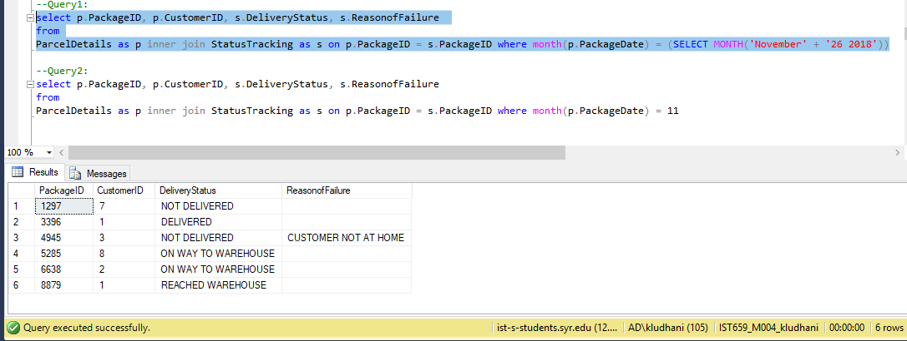
Major Data Question1 : Track the status of all package in the month of November

Slide 9
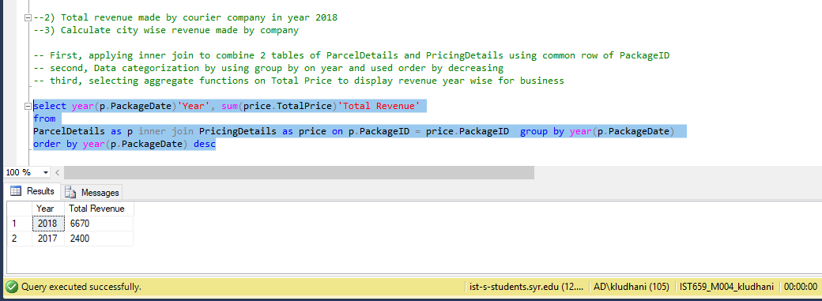
Major Data Question 2: Total revenue made by Courier Company in each year.

Slide 10
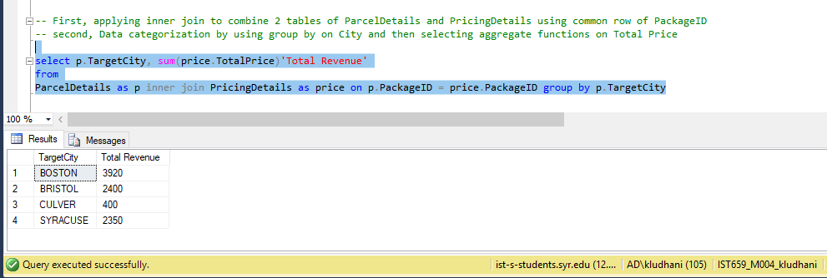
Major Data Question 3: Calculate city wise revenue made by company

Slide 11
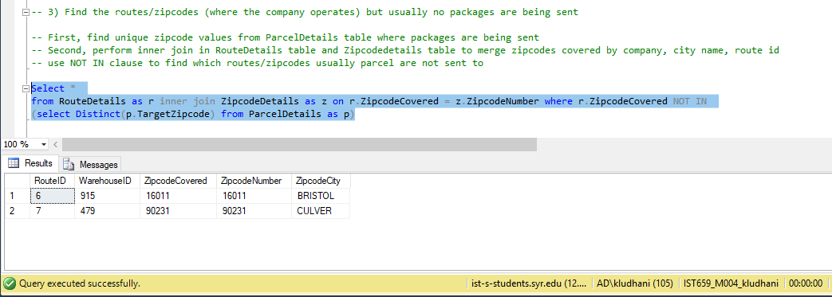
Major Data Question 4: Find the routes/zipcodes (where the company operates) but usually no packages are being sent

Slide 12
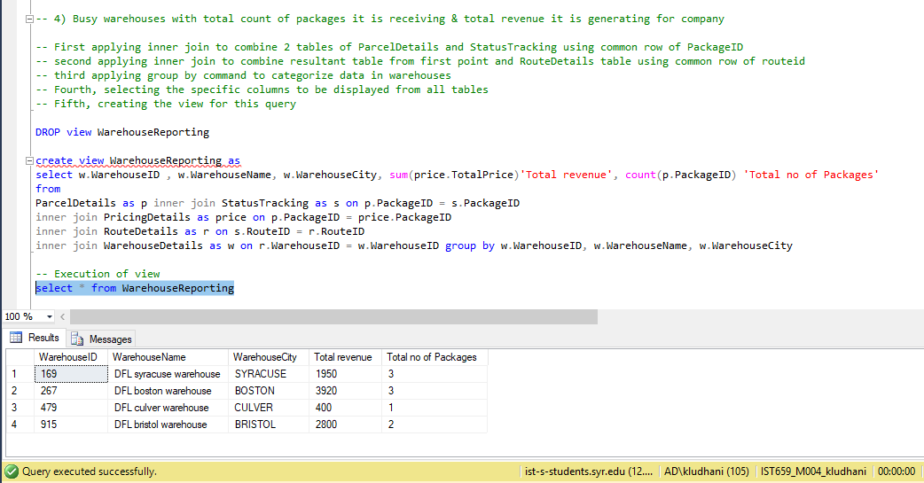
Major Data Question 5: Busy warehouses with total count of packages it is receiving & total revenue it is generating for company

Slide 13
Data question 5 report

Slide 14
Form 1:

Slide 15
Form 2:

Slide 16
Form 3:

Slide 17
Form 4:

Slide 18
TRIGGER 1 :
When entry is inserted from FORM (in Access) it comes in format:
Example : INSERT into ParcelDetails values (3339,0.5,100,'','Praneet','Kuppa','315-679-7979',835, 'Avolande’, 'BOSTON','Massachusetts',41699,1)
Whereas to insert system date in sql server, entry is required in format:
INSERT into ParcelDetails (PackageID,PackageWeight,PackageDistance, TargetCustomerFname, TargetCustomerLname,TargetPhone, TargetStreetno, TargetStreetname, TargetCity, TargetState,TargetZipcode,CustomerID) values (8879,0.5,100,'Praneet','Kuppa','315-679-7979',835,'Avolande’, 'BOSTON’, 'Massachusetts',41699,1)
This trigger is built it performs below function
1) Allows Inserts entry in system with default date
2) Update default date with system date

Slide 19
Procedure:
It takes RateID and PackageID as input to calculate the other 3 fields (DeliveryTypePrice, TotalDistancePrice, TotalWeightPrice) of PricingDetails table

Slide 20
Trigger 2:
Triggers the stored procedure after insert of below row in the table from Access form

